Slide 1


Studio Shodwe
introduction
to shading
PHONG VS GOURAUD SHADING MODELS IN BLENDER
01

Slide 2
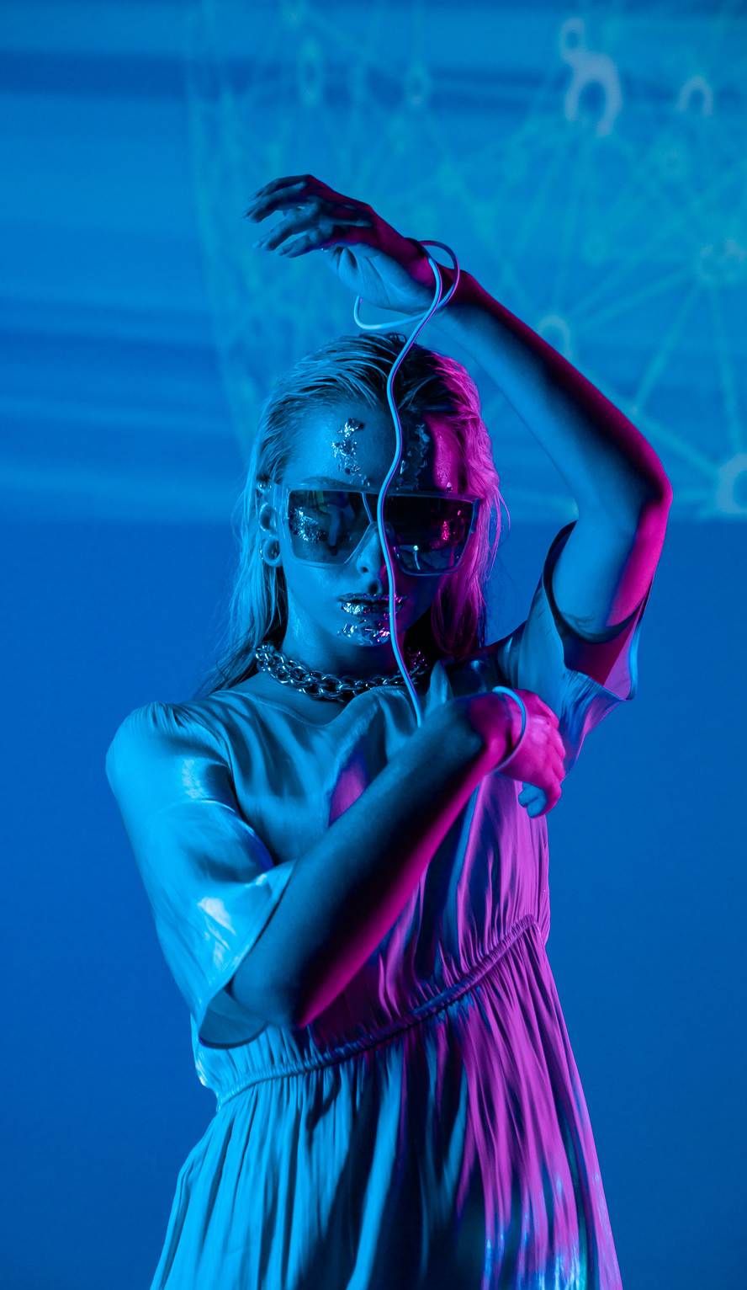
Group 24 members
01
Gatmach Yuol Nyuon
02
Newton Luttah
03
Rebecca Shirievo
04
Derrick Gacheru
03

Slide 3

a) Create a YouTube video Illustrate using step by step how the two shading methods can be achieved in Blender for a circle of radius 3 starting from the center share the link
Q24
a)Phong Shading model
b) Gaurand Shading model
04

Slide 4

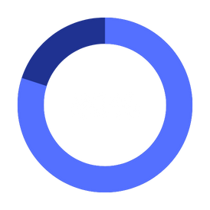
What is shading?
Shading is a technique in 3D computer graphics that simulates the effects of on surfaces, enhancing the perception of depth and realism
Importance
Proper shading is crucial for achieving realistic renders, as it affects how materials and textures appear under various lighting conditions
02

Slide 5
Overview of shading techniques
Flat Shading: Applies a single color to each polygon, resulting in a faceted look.​
Gouraud Shading: Interpolates vertex colors across polygons for smoother transitions.
01
02
Phong Shading: Computes color at every pixel using normal interpolation and light reflection model.
03
03

Slide 6
01
INTRODUCTION
Developed by Henri Gouraud in 1971
Interpolation technique for computer graphics
Creates smooth shading across polygonal surfaces
02
Methodologies
Vertex Normal Calculation
Lighting Computation:al Calculation
Gouraud Shading (Vertex-Based)
Color Interpolation
04

Slide 7


Studio Shodwe
Steps to draw a circle using gouraud shadingion
Since circles aren’t natively supported in Gouraud (which works with polygons), you approximate the circle by creating a regular polygon:
Choose the number of sides, e.g., n = 24
Compute the coordinates for each vertex around a center:
(xi​,yi​)=(r⋅cos(θi​),r⋅sin(θi​))
where:
r = 3 (radius), θi = 2πi/n
Connect each adjacent vertex to the center (0,0) to form triangular sectors.
05

Slide 8

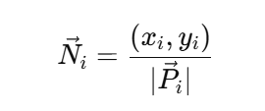
Step 2: Assign Normals to Vertices
At each vertex compute a normal vector pointing outward from the center:
These normals are used for lighting calculations.
06

Slide 9


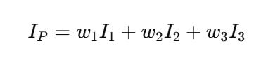
Studio Shodwe
Step 4: Triangulate and Interpolate Colors
Each triangle has 3 vertices with intensities I1, I2, I3
To shade any point P within the triangle, compute barycentric coordinates (w1,w2,w3) for that point and apply the interpolation:
This gives the final pixel color at P.
This interpolation creates a smooth gradient effect across the triangle.
07

Slide 10
Studio Shodwe
Step 5: Render the Circle
Now render each triangle of the polygon:
Use the interpolated values across each triangle
The result is a smooth-shaded circle where light smoothly transitions across the surface
08

Slide 11


drawing a Circle in Blender with Gouraud Shading
Working Example:
Click here
09

Slide 12
01
ADVANTAGES
Computationally efficient compared to more complex shading techniques.
Produces smoother shading than flat shading by reducing the faceted appearance of polygonal models.
LIMITATIONS
02
Cannot capture specular highlights within polygons
Produces visual artifacts like Mach bands at shading transitions
04

Slide 13
Studio Shodwe
Applications
Early computer graphics and video games for smooth shading with limited resources
Still used when computational efficiency matters more than detailed specular effects
08

Slide 14
01
INTRODUCTION
Developed by Bui Tuong Phong in 1973.
Presented in his Ph.D. thesis at the University of Utah.
Major advancement in computer graphics rendering techniques.
DEFINITION:
02
Phong Shading is an interpolation method used in 3D computer graphics.
It performs per-pixel lighting calculations, resulting in realistic shading across curved surfaces.
phong Shading (pixel-Based)
04

Slide 15
Studio Shodwe
How It Works – Key Steps
Vertex Normal Calculation:
Like Gouraud shading, it starts with normals at each vertex, typically averaged from adjacent faces.
Interpolation of Normals (Not Colors):
The normals are linearly interpolated across each pixel in the triangle, not the colors.
Lighting Computation per Pixel:
At every pixel, the Phong illumination model is applied using the interpolated normal vector.
05

Slide 16
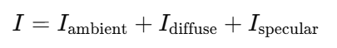
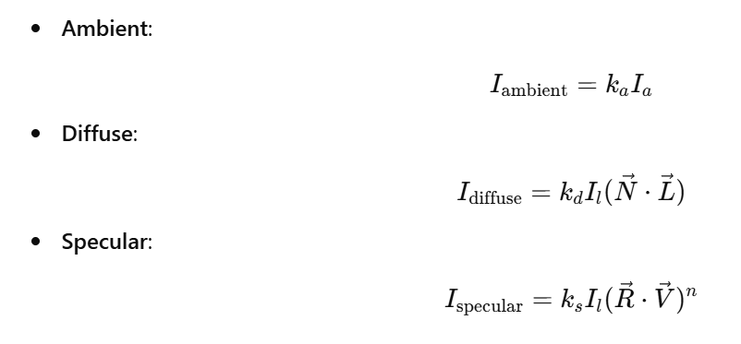
Phong Illumination Model Formula
With ach component defined as:
06

Slide 17
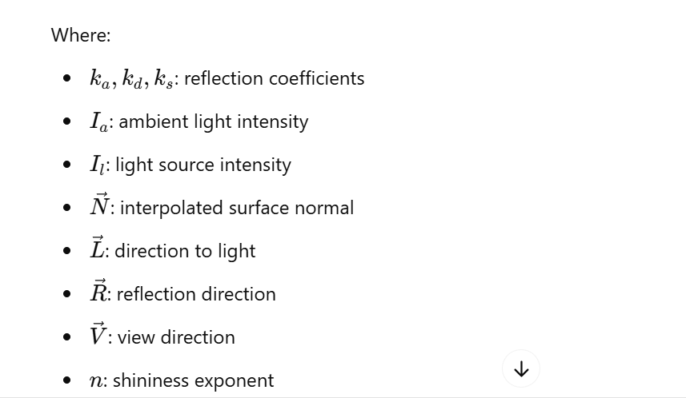
Studio Shodwe
08

Slide 18
Modeling and Rendering a Circle in Blender Using Phong shading
Working Example:
Click here
09

Slide 19
01
ADVANTAGES
Produces realistic and smooth highlights
Specular reflections are accurately represented
Ideal for curved surfaces like spheres or complex models
LIMITATIONS
02
More computationally expensive than Gouraud shading
Slower rendering in real-time applications due to per-pixel calculations
Not physically accurate (compared to more modern PBR)
04

Slide 20
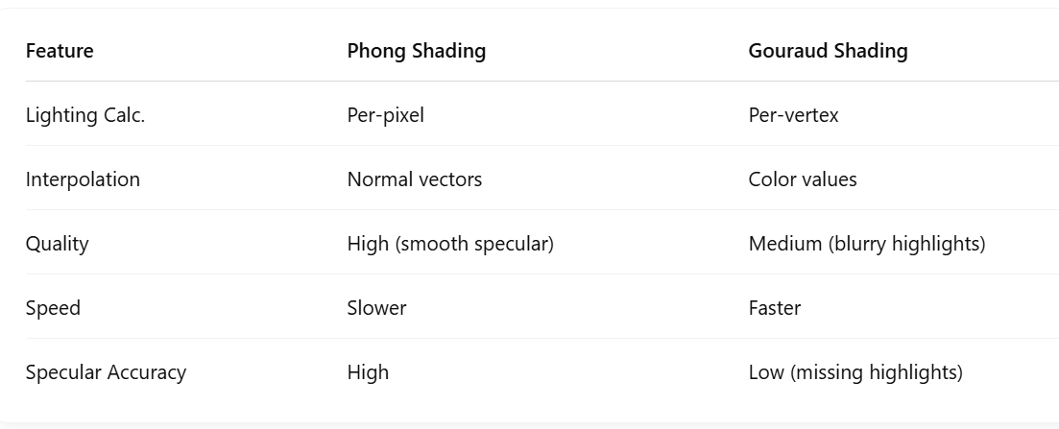
Studio Shodwe
comparison table
08

Slide 21
Thank You
For listening
10

